Slide 1

Event Sourcing with Marten
November 10th, 2022

Slide 2

About Marten
Open Source .NET Library
Uses PostgreSQL for Persistence
ACID Compliant Document Store
Integrated Event Sourcing
https://martendb.io

Slide 3
Why Postgresql?
Outstanding JSON Support
JavaScript in the Database
Docker Friendly
Hosting Options
FOSS
Vibrant Community
Very Capable

Slide 4

Event Sourcing
A style of system persistence where each state change is captured and stored as an explicit event object

Slide 5
Advantages to Event Sourcing
Usage of Business Language
Audit Log
Temporal Querying / “Time Travel”
Retrofitting Metrics
Complement to CQRS
Concurrency

Slide 6
Let’s build a ride sharing system!

Slide 7
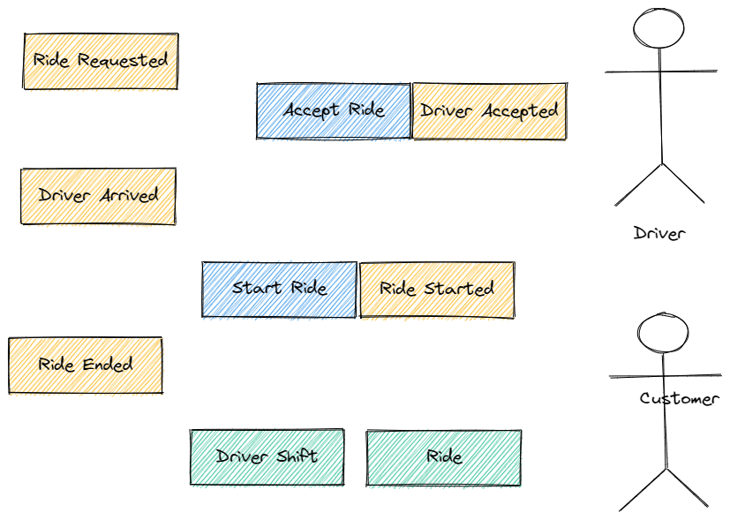
Event Storming

Slide 8
Appending Events

Slide 9
Projections and Aggregations
Inline
Live
Asynchronous

Slide 10

Fast Web Services

Slide 11

Putting the “C” in CQRS
Establish a transactional boundary
Fetch the existing “write model” state for validation
Concurrency concerns
Decide what new events should be persisted
Publish outgoing events
Persist events

